Slide 1



IT 493 Assignment 2 - Project Integration Management
Tour Catchers LLC
Team #4
Tour Catchers LLC​ – Team 4
1

Slide 2
AGENDA
Quality Management Plan
Individual Assignments
Project Integration Plan
Lessons Learned Register
Software Tools
Risk Management Plan
Tour Catchers LLC​ – Team 4
2

Slide 3

Section 1 – Individual Assignments

Slide 4
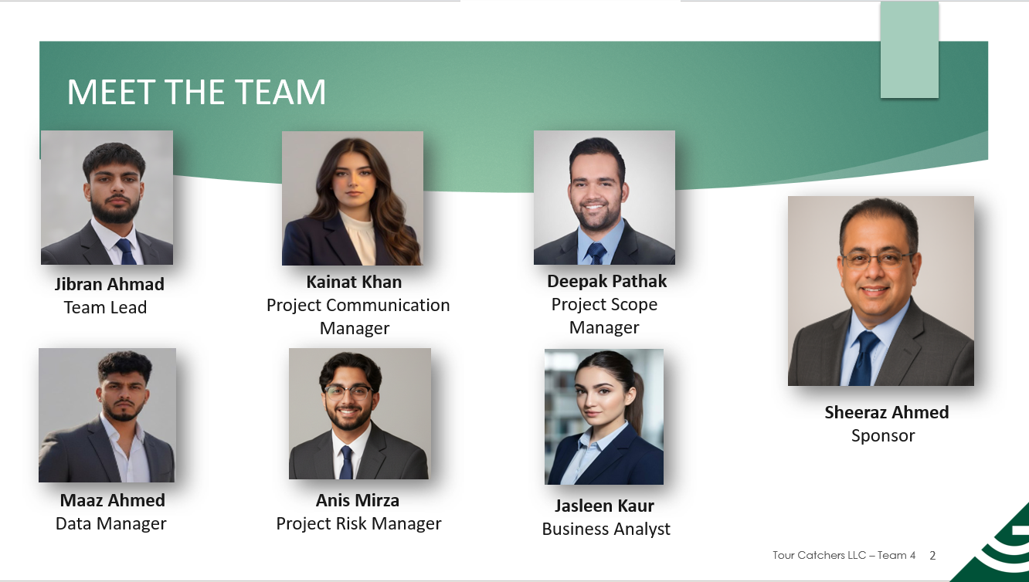
Tours Catchers LLC​ – Team 4
4

Slide 5
Individual Assignments
Team Member | General Tasks | Individual Assignment Tasks
Jibraan Ahmad - Team Lead | • Schedule and lead team meetings (agenda)• Maintain overall project plan• Manage Microsoft Teams and shared documents• Coordinate sponsor communication and approvals | • Assignment 2: Project Integration Management• Assignment 19: IT 493 Project Poster• Project Status Report: Assigned Week
Kainat Khan - Project Communication Manager | • Primary point of contact for sponsor communication• Prepare meeting agendas and take sponsor meeting notes• Keep communication records and follow-ups | • Assignment 4: Project Communications Management• Assignments 4.1, 4.2, 4.3: Communication Reports 1–3• Project Status Report: Assigned Week
Deepak Pathak - Project Scope Manager | • Define and control project scope• Document and track scope changes• Ensure deliverables align with sponsor requirements | • Assignment 9: Final Business Processes and Quantification• Assignment 13: Transition Documentation• Project Status Report: Assigned Week
Maaz Ahmed - Data Manager | • Document and analyze business sponsor data• Maintain data accuracy and consistency across documents• Support reporting and quantification efforts | • Assignment 9: Final Business Processes and Quantification (Data Support)• Assignment 13: Transition Documentation (Data Inputs)• Project Status Report: Assigned Week
Anis Mirza - Project Risk Manager | • Identify and document project risks• Maintain and update the risk register• Lead risk discussions during meetings | • Assignment 10: Project Risk Management Updates• Risk Register Maintenance (IT 492 → IT 493)• Project Status Report: Assigned Week
Jasleen Kaur - Business Analyst | • Gather and analyze business requirements• Translate sponsor needs into system requirements• Support testing and validation activities | • Assignment 7: Test Plans and Test Scripts• Assignment 10: Test Results• Assignment 8: Training Plan (Business Perspective)• Project Status Report: Assigned Week

Slide 6

Section 2 – Project Integration Plan

Slide 7

Project Background
Project Title: Tour Catchers LLC – Booking + AI Support + CRM Integration
Project Overview: Tour Catchers will modernize how bookings, customer support, and customer data are handled by integrating:
A web/mobile booking application
Dialpad AI for customer support + feedback
Bitrix CRM for centralized customer data and retention
Objectives
Reduce manual phone/email booking work
Improve customer response time with 24/7 AI support
Store booking + customer data in one system (Bitrix)
Support business growth with cloud-based tools

Slide 8
Project Scope
In Scope
Online booking workflow (tour selection → availability → payment → confirmation)
Dialpad AI support + post-trip feedback automation
Bitrix CRM setup for storing customer/booking data and follow-ups
Data integration between booking app, Dialpad AI, and Bitrix CRM
Out of Scope
Major changes to sponsor requirements after design approval
Non-web-based solution (must remain cloud/web)
Any solution that does not work with existing Tour Catchers workflows

Slide 9
Project Requirements
Web / Mobile Booking Workflow
Customers can select a tour, system checks availability, customer pays, and a confirmation is sent automatically.
Automated Confirmation & Follow-Ups
Booking confirmations and follow-up messages are automated so customers and staff do not rely on manual emails or calls.
Dialpad AI (Support + Feedback)
Provides 24/7 responses to common questions and collects post-trip feedback automatically to reduce manual support work.
Bitrix CRM Data Management
Booking and customer data is stored in Bitrix CRM and access is limited to the right staff for organized customer management.
Security & Role-Based Access Control
Customer data must be protected and only accessible based on user role (approved staff only).
System Integration & Compatibility
The booking app must integrate with Dialpad AI and Bitrix CRM using reliable data flow, and work across devices/browsers.
User Training & Documentation
Provide simple guides and a walkthrough so Tour Catchers can adopt the system quickly with minimal training time.

Slide 10
DELIVERABLES
Goal: Improve customer experience and business operations with a streamlined digital system.
Helps support customer retention with reminders and follow-ups
Online Booking System (OBS):
Customers can choose a tour and submit a booking online
Availability is checked to reduce double bookings
Automatic booking confirmation is sent after submission/payment
AI Support & Feedback System (Dialpad AI):
24/7 answers for common questions (tours, pricing, policies)
Routes customers to staff when needed
Sends post-trip feedback questions and stores responses
Customer Relationship Management (Bitrix CRM):
Central place to store customer + booking information
Tracks booking status and follow-up history

Slide 11
EXECUTION
What can Tour Catchers expect from our team during the project’s implementation?
Clear Communication and Regular Updates
Weekly progress updates on tasks and milestones
Regular meetings to review changes, questions, and next steps
Collaborative Approach
Sponsor feedback built into key checkpoints
Quick follow-ups so priorities stay aligned
System Development and Configuration
Build the online booking workflow (request → confirmation)
Configure Dialpad AI and set up Bitrix CRM for customer data
Quality Assurance and Testing
Test each feature to make sure it works as expected
User acceptance testing (UAT) with the sponsor before final delivery
Post-Implementation Support
Support after deployment to ensure smooth use
Provide basic training + help with small updates if needed

Slide 12

Section 3 – Lessons Learned Registers

Slide 13
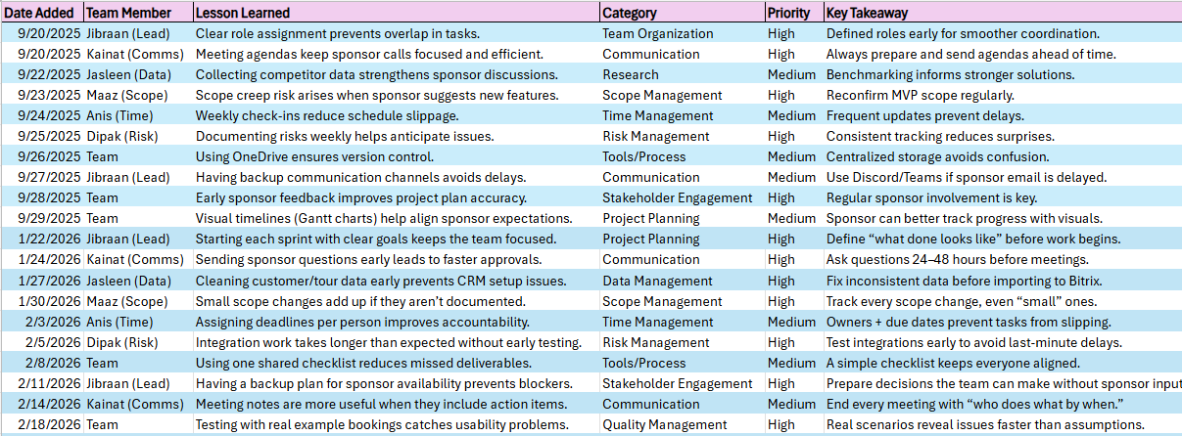
Lessons Learned Registers – IT 492 & 493

Slide 14
MAINTAINING LESSONS LEARNED REGISTER
Helps us repeat what works and avoid repeating mistakes
Who maintains it
The register is maintained by the Data Manager: Maaz Ahmed
It is stored in OneDrive and accessible to all team members
How we keep it updated
Updated after every sponsor meeting and weekly team meeting
Team members share lessons during meetings, and the DataManager records them
The Team Lead reviews entries to confirm accuracy and clarity
How we classify lessons (Priority)
High: Could impact schedule, scope, sponsor approval, or systemsuccess
Medium: Improves teamwork and quality, but does not blockprogress
Low: Helpful improvements with minimal impact if missed
How we use it
Reviewed before major decisions (scope, tools, timeline updates)

Slide 15

Section 4 – Software tools

Slide 16
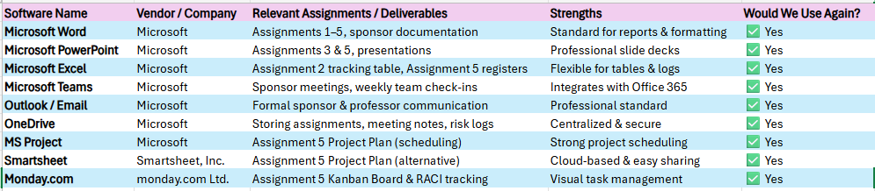
Software Tools Repository – IT 492 & 493​
What we updated from IT 492
We expanded the repository to include all tools we actively use in IT 493 (documentation, planning, communication, and tracking).
We added a “Would We Use Again?” column to confirm which tools are effective and worth continuing.
Who maintains it
Responsible Owner: Data Manager – Maaz Ahmed
The register is stored in OneDrive and accessible to all team members.
Updates are reviewed during weekly team check-ins.

Slide 17
We review the repository weekly during team check-ins
Any new tool must be added with purpose, owner, and what deliverable it supports
Tools are kept consistent, so the sponsor and team always use the same versions
Central storage in OneDrive prevents confusion and duplicate files
Helps the team stay organized and meet deadlines
Keeps sponsor communication clear and professional
Supports planning (schedule + Kanban) and tracking (logs + registers)
Makes it easier to document and deliver a clean handoff
How We Manage the Tools Repository
Why These Tools Work for Tour Catchers​

Slide 18

Section 5 - Risk management plan ​

Slide 19
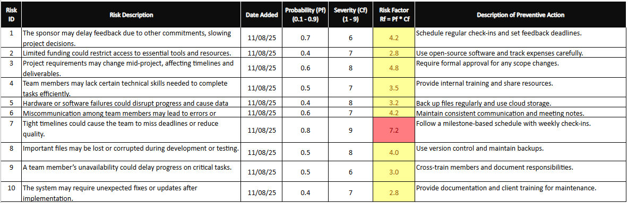
Risk Register – IT 492 & 493

Slide 20

What was updated from IT 492
We reviewed all IT 492 risks and updated them for the IT 493 implementation phase.
We updated risk status, remarks, and dates based on current project progress.
We added new risks related to implementation, integration, and sponsor availability.
Risk Register Owner
Responsible Owner: Project Risk Manager – Anis Mirza
Stored in OneDrive so all team members can access the latest version.

Slide 21

Section 6 – Quality Management Plan ​​

Slide 22


Quality Management Plan(Updated from IT 492)
Goal: Ensure the full Tour Catchers system works correctly, is easy to use, and meets sponsor expectations.
How we verify quality as a team
We verify each feature works during development (team testing)
We validate the full system with sponsor feedback and UAT before launch
We log issues, fix them, and re-test until they are resolved

Slide 23
Project Milestones for Quality
User Acceptance Testing (UAT)​
System meets requirements / validated by sponsor / ready for launch​
Sponsor tests real scenarios (booking, confirmations, follow-ups)​
Collect sponsor feedback and apply final improvements​
Sponsor confirms acceptance criteria are met​
Launch​
Receive feedback, make necessary updates, monitor​
Deliver final walkthrough + documentation​
Support initial use and handle minor fixes if needed​
​
Development
Develop core features and requirements for the project
Build booking workflow, CRM setup, and Dialpad AI setup
Confirm each feature matches sponsor requirements
Alpha Testing
Identify bugs / test key features / fix bugs
Team tests basic workflows end-to-end
Fix issues found and re-test until stable
Beta Testing
Evaluate usability and security, fix issues from alpha
Test for ease of use (customer + staff perspective)
Check role access and data handling
Fix UI or workflow problems found

Slide 24
Citations
George Mason University, Department of Information Sciences and Technology. (2025). Assignment 3: Business analysis and sponsor needs [Course assignment]. IT 492: Senior Design Project I.
George Mason University, Department of Information Sciences and Technology. (2025). Assignment 5: Project integration management [Course assignment]. IT 492: Senior Design Project I.
George Mason University, Department of Information Sciences and Technology. (2025). Assignment 8: Solutions evaluation and selection [Course assignment]. IT 492: Senior Design Project I.
Tour Catchers LLC. (2026). Sponsor meeting notes and feedback (IT 492–IT 493) [Unpublished internal documents].
Team 4. (2026). Lessons learned register (updated for IT 493) [Unpublished internal document].
Team 4. (2026). Risk register (updated for IT 493) [Unpublished internal document].
Team 4. (2026). Software tools repository (updated for IT 493) [Unpublished internal document].

